Slide 2



Notifications

Slide 3
Recommendations

Slide 4
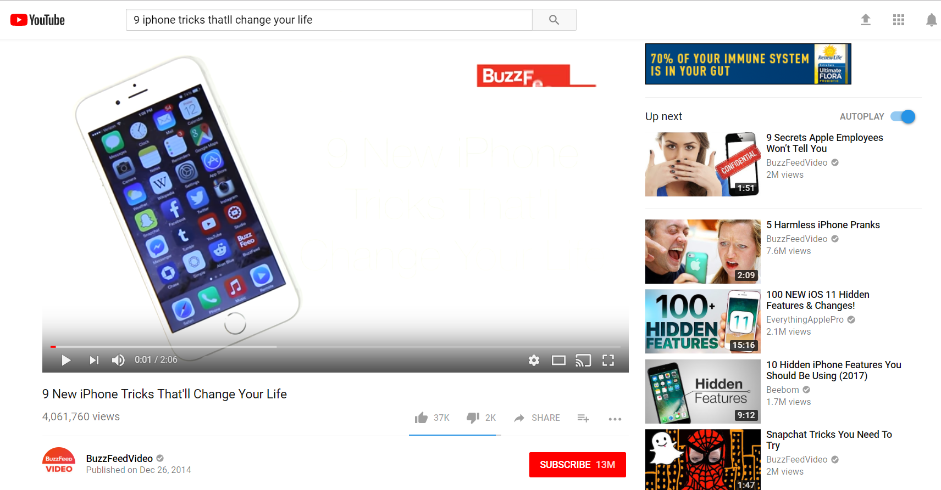

Slide 5
History
Likes/Dislikes
Algorithm
Recommendation
Current Video

Slide 6
Gamification

Slide 7
